Slide 1
Experimental Design For Engineers
ISYE435-535

Slide 2
Design of Engineering Experiments
– Introduction to Factorials
Text reference, Chapter 5
General principles of factorial experiments
The two-factor factorial with fixed effects
The ANOVA for factorials
Extensions to more than two factors
Quantitative and qualitative factors – response curves and surfaces

Slide 3
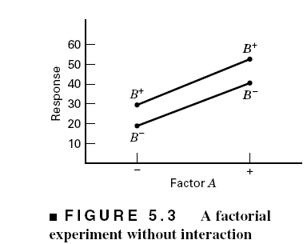
Some Basic Definitions
Definition of a factor effect: The change in the mean response when the factor is changed from low to high

Slide 4
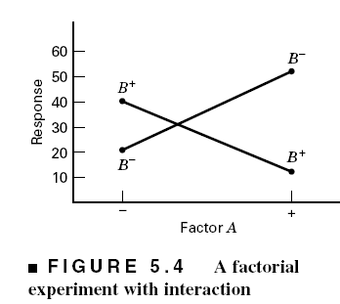
The Case of Interaction

Slide 5
Regression Model & the Associated Response Surface

Slide 6
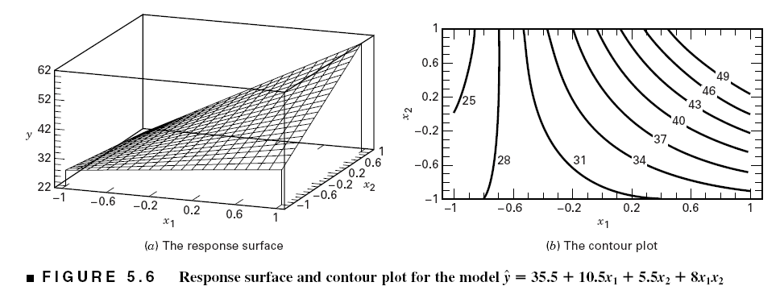
The Effect of Interaction on the Response Surface
Suppose that we add an interaction term to the model:
Interaction is actually a form of curvature

Slide 7
Example 5.1: The Battery Life Experiment
Text (page 183)
A = Material type; B = Temperature (A quantitative variable)
What effects do material type & temperature have on life?
2. Is there a choice of material that would give long life regardless of temperature (a robust product)?

Slide 8
The General Two-Factor
Factorial Experiment
a levels of factor A; b levels of factor B; n replicates
This is a completely randomized design

Slide 9
Statistical (effects) model:
Other models (means model, regression models) can be useful

Slide 10
Extension of the ANOVA to Factorials (Fixed Effects Case)

Slide 11
ANOVA Table – Fixed Effects Case
Design-Expert will perform the computations
Text gives details of manual computing (ugh!) – see page 189

Slide 13
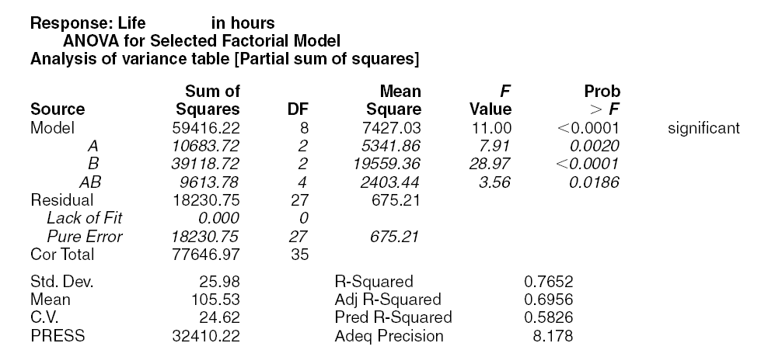
Design-Expert Output – Example 5.1

Slide 14
Residual Analysis – Example 5.1

Slide 15
Residual Analysis – Example 5.1

Slide 16
Interaction Plot

